Slide 1
Walla Walla PSP:
2024 Water Quality Monitoring Results
June 16, 2025
Walla Walla Basin Watershed Council Board Meeting (Virtual)
David Gruen | Oregon Department of Environmental Quality

Slide 2
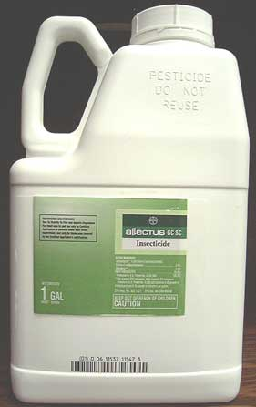
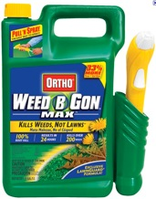
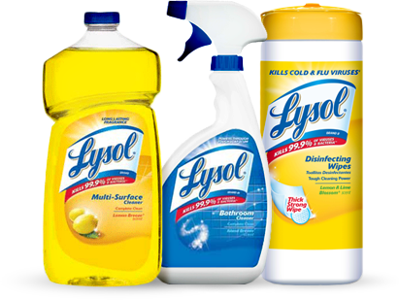

Pesticides in Oregon
Over 1,200 registered active ingredients
Over 15,000 registered pesticide products
agricultural pesticides, home products, pet products, mosquito repellents, cleaners, pool/spa chemicals, etc.…
a.i. Bifenthrin in
> 150 products
a.i. Fipronil in
> 160 products
Notes:
- No. of pesticide active ingredients
- No. registered pesticide products
- Diversity of products – including disinfectants, flea powders, lawn and garden weed chemicals

Slide 3
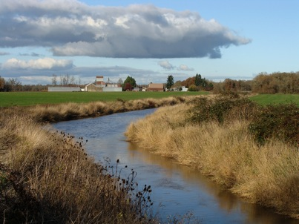
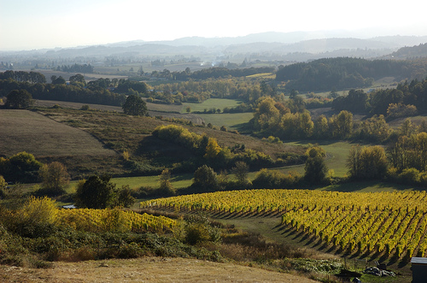
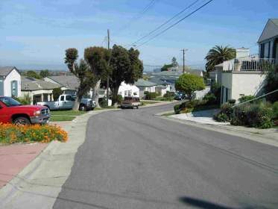



Pesticides in Oregon

Slide 4
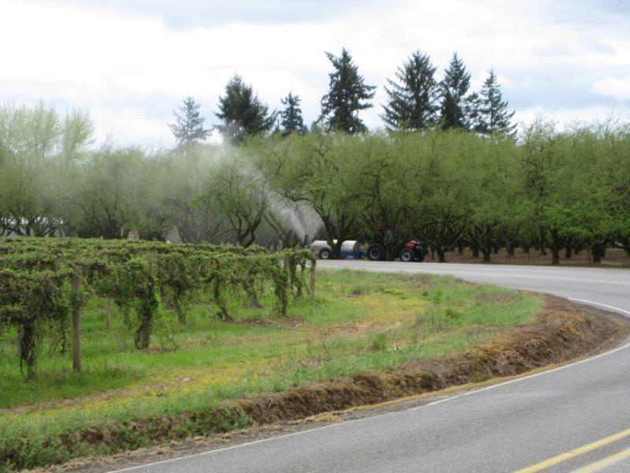
Notes:
This photo illustrates the challenge of sorting out the various sources of pesticides in water, with orchard spray drift potentially mixing with roadway use pesticides that runoff to ditches (foreground).

Slide 5
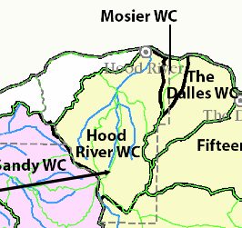
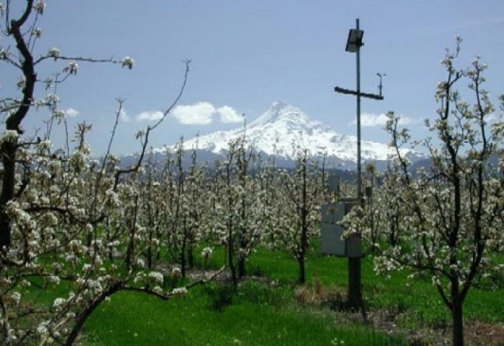
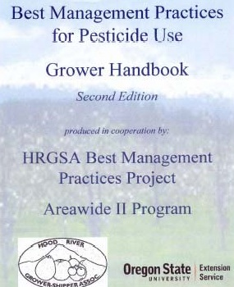
Pesticide Stewardship Partnership: The Beginning
1999: Organophosphate insecticides detected above WQS for fish
2000: Coordinated Program Developed
    State Agencies – DEQ monitoring
    Local Stakeholders: Growers and Shippers, SWCD, WSC, Irrigation Districts & Confederated Tribes of Warm Springs
2002-03: Voluntary Best Management Practices (BMPs)
    Application Practices, buffers, etc.
    Outreach/Training
    Technical expertise, resources & pesticide management tools in place
Notes:
History:
Started in Hood River in 1999-2000, when insecticides found in streams above in-stream standards.
Local stakeholders approach voluntary, collaborative approach to solving the problem, rather than the standard regulatory responses
DEQ agreed, and all of the local partners (listed above) followed through with multiple actions and outreach efforts, including the development of a best practices handbook developed by the growers with the help of OSU Extension Service.
Led DEQ about taking PSP APPROACH IS UNIQUE TO PESTICIDES - because of the expertise, tools and resource to make improvements that can minimize pesticides getting into water

Slide 6
Pesticide Stewardship Partnerships (PSPs)
Key Steps in Partnership Projects
Monitor for 136 pesticides
Identify streams with elevated pesticide concentrations or high number of detections
Collaborate with local partners to implement voluntary management practices
Conduct follow-up monitoring to track water quality through time
Add and/or remove sites based on evaluation of water quality data
Partners can include: agricultural producer groups, SWCDs, OSU Extension, watershed councils, tribes
Notes:
We identify streams with elevated pesticides and where pesticides are below benchmarks to help understand and communicate where management is working well.

Slide 7
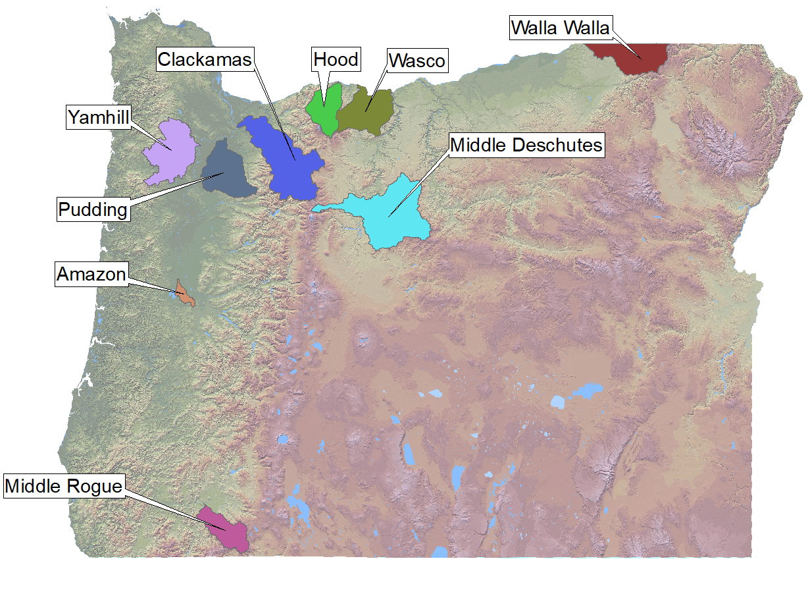
PSP Program: Objectives
Goal: promote voluntary changes in pesticide use practices that improve water quality
Combines local expertise and water quality sampling results to evaluate reasons for pesticide occurrences and recommend potential solutions
Notes:
Began in Hood River area as a collaborative alternative to addressing exceedances of pesticide water quality criteria
Goal: Use water quality data to drive voluntary changes in pesticide use practices that measurably improve water quality
Until 2013, PSP funded by
grants, toxics monitoring funds,
and in-kind partner contributions
Since 2013, Legislature has provided stable funding for monitoring and other program elements
50% General Fund
50% Pesticide Registration Fees

Slide 8
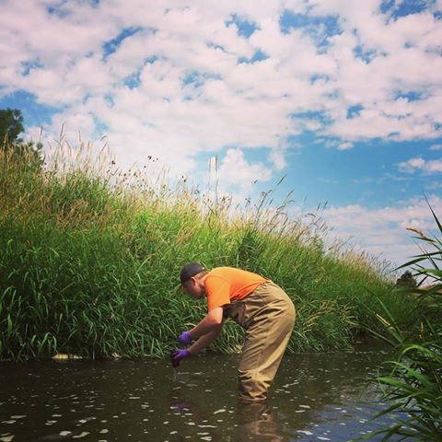
PSP Sampling
Weekly discrete monitoring provides conservative estimates of pesticide related ecological impacts (Nowell et al. 2021):
PSP sampling underestimates acute exposure to pesticides in small streams
  Samples collected following runoff events tend to have higher concentrations than those collected at regular intervals
  Aquatic communities may be adversely affected at lower pesticide concentrations than expected based on single-species laboratory bioassays
Nowell, Lisa H., Patrick W. Moran, Laura M. Bexfield, Barbara J. Mahler, Peter C. Van Metre, Paul M. Bradley, Travis S. Schmidt, Daniel T. Button, and Sharon L. Qi. 2021. “Is There an Urban Pesticide Signature? Urban Streams in Five U.S. Regions Share Common Dissolved-Phase Pesticides but Differ in Predicted Aquatic Toxicity.” Science of The Total Environment 793 (November): 148453. https://doi.org/10.1016/j.scitotenv.2021.148453.
Notes:
The underestimation of pesticide concentrations from weekly discrete sampling is particularly true for insecticides which are often transient and tend to be highly toxic to invertebrates.
Also not all analytes have ALBs to compare against.
No additive pesticide toxicity index used.
Minimum estimates, but do serve to provide ecological health context.

Slide 9
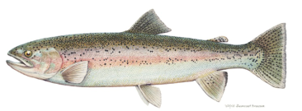
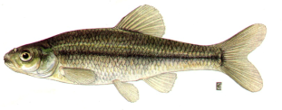
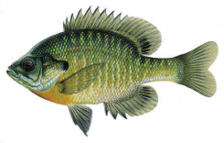
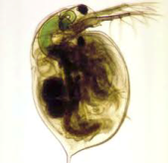
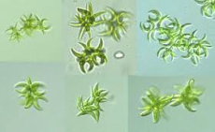
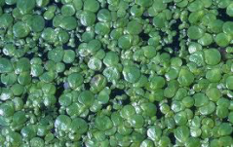
How are Monitoring Data Evaluated?
EPA Aquatic Life Benchmarks (ALB) in ug/L (ppb)
  Most sensitive acute & chronic toxicity data for each group of organisms represented for EPA risk assessments
  Helps identify and prioritize pesticides & locations
Rainbow trout
Fathead minnow
Bluegill sunfish
Daphnia magna
Green algae
Duckweed
2. Aquatic Life Ratio:
  Detected concentration (ug/L) / lowest (acute or chronic) ALB
Values ≥ 1.0 indicates further attention required
3. Frequency of Detection & Mixtures
  Percentage of samples chemical detected in & number of pesticides in a sample
Notes:
Acute Fish Benchmark = Toxicity value x LOC. For acute fish, toxicity value is generally the lowest 96-hour LC50 in a standardized test (usually with rainbow trout, fathead minnow, or bluegill), and the LOC is 0.5.
Chronic Fish Benchmark = Toxicity value x LOC. For chronic fish, toxicity value is usually the lowest NOEAC from a life-cycle or early life stage test (usually with rainbow trout or fathead minnow), and the LOC is 1.
Acute Invertebrate Benchmark = Toxicity value x LOC. For acute invertebrate, toxicity value is usually the lowest 48- or 96-hour EC₅₀ or LC₅₀ in a standardized test (usually with midge, scud, or daphnids), and the LOC is 0.5.
Chronic Invertebrate Benchmark = Toxicity value x LOC. For chronic invertebrates, toxicity value is usually the lowest NOAEC from a life-cycle test with invertebrates (usually with midge, scud, or daphnids), and the LOC is 1.
Acute Non-Vascular Benchmark = Toxicity value x LOC. For acute nonvascular plants, toxicity value is usually a short-term (less than 10 days) EC₅₀ (usually with green algae or diatoms), and the LOC is 1.
Acute Vascular Benchmark = Toxicity value x LOC. For acute vascular plants, toxicity value is usually a short-term (less than 10 days) EC50 (usually with duckweed) and the LOC is 1.

Slide 10
2024 Water Quality Data Summary
2025 Pesticides of Concern (data evaluated: 2022 – 2024)
  1 Pesticides of High Concern:
    Imidacloprid – 1 detection out of 187 samples
  2 Pesticides of Moderate Concern:
    Glyphosate – 31 detections out of 66 samples
    Pyriproxyfen – 1 detection out of 187 samples
Exceedances of Aquatic Life Benchmarks in 2024:
  Imidacloprid at West Prong Walla Walla River South of Stateline in May

Slide 11
Decision Matrix Based on Water Quality Monitoring Data (2019) Detected concentration relative to aquatic life benchmark (ALBs) and frequency of detection
Reference Level Criteria
Frequency of Detection in Last 3 Years (%) |  | ≥ 1 detection at or above 50% of an acute ALB | ≥ 3 detection at or above 50% of a chronic ALB | 1 - 2 detections at or above 50% of a chronic ALB | No detections over 50% of any ALB
 | 65.1% - 100% | High Level of Concern | High Level of Concern | High Level of Concern | Moderate Level of Concern
 | 35.1% - 65% | High Level of Concern | High Level of Concern | Moderate Level of Concern | Moderate Level of Concern
 | 0% to 35% | High Level of Concern | High Level of Concern | Moderate Level of Concern | Low Level of Concern
11

Slide 12
Decision Matrix Based on Water Quality Monitoring Data (2019) Detected concentration relative to aquatic life benchmark (ALBs) and frequency of detection
Reference Level Criteria
Frequency of Detection in Last 3 Years (%) |  | ≥ 1 detection at or above 50% of an acute ALB | ≥ 3 detection at or above 50% of a chronic ALB | 1 - 2 detections at or above 50% of a chronic ALB | No detections over 50% of any ALB
 | 65.1% - 100%
 | 35.1% - 65% |  |  |  | Glyphosate
 | 0% to 35% | Imidacloprid |  | 1. Pyriproxyfen
2025 Pesticides of Concern – Yamhill PSP:
[Based on data from 2022-2024]

Slide 13
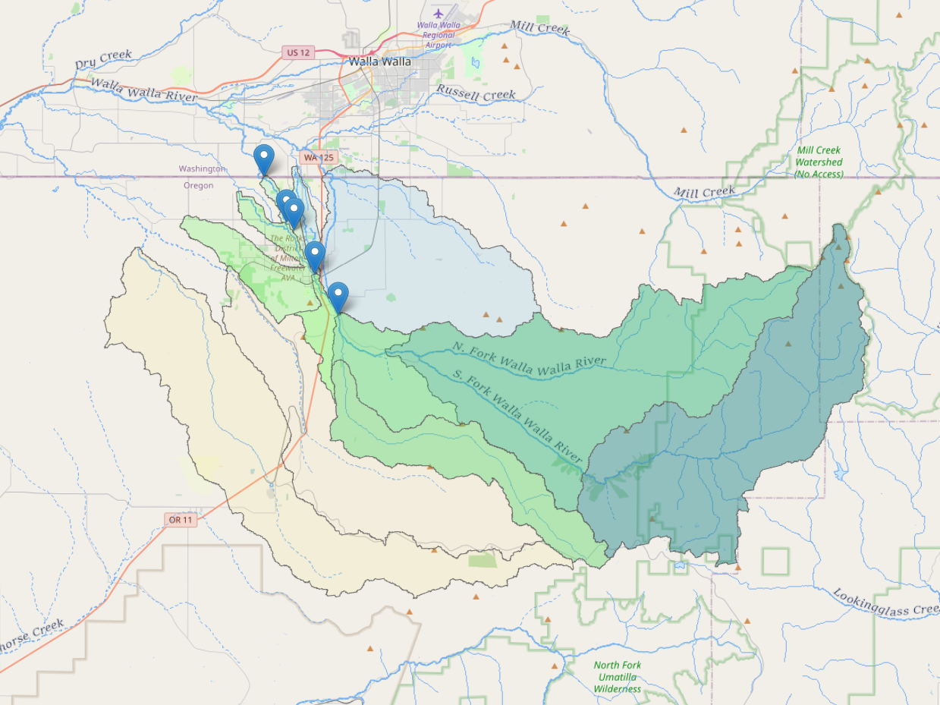
2024 Walla Walla PSP Sampling Locations

Slide 14
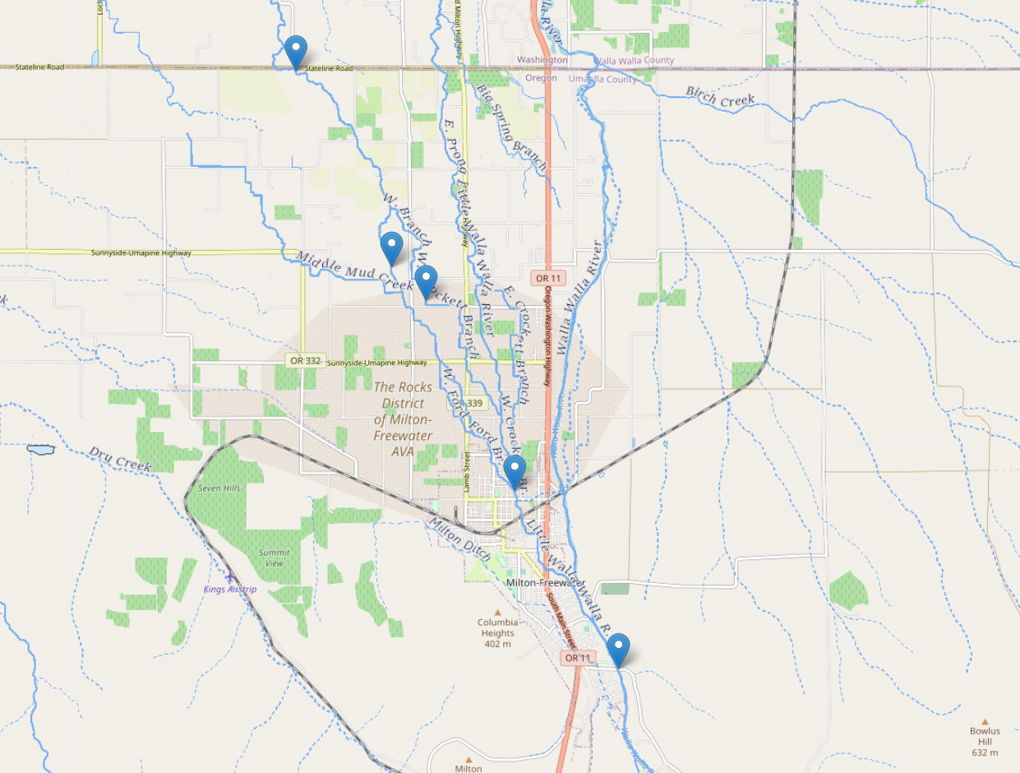
2024 Walla Walla PSP Sampling Locations
West Prong Little Walla Walla – South of Stateline Road
Little Walla Walla – Mid Prong West
Little Walla Walla River – West Branch/Crockett
Little Walla Walla River at The Frog
Walla Walla River at Grove School Bridge

Slide 15
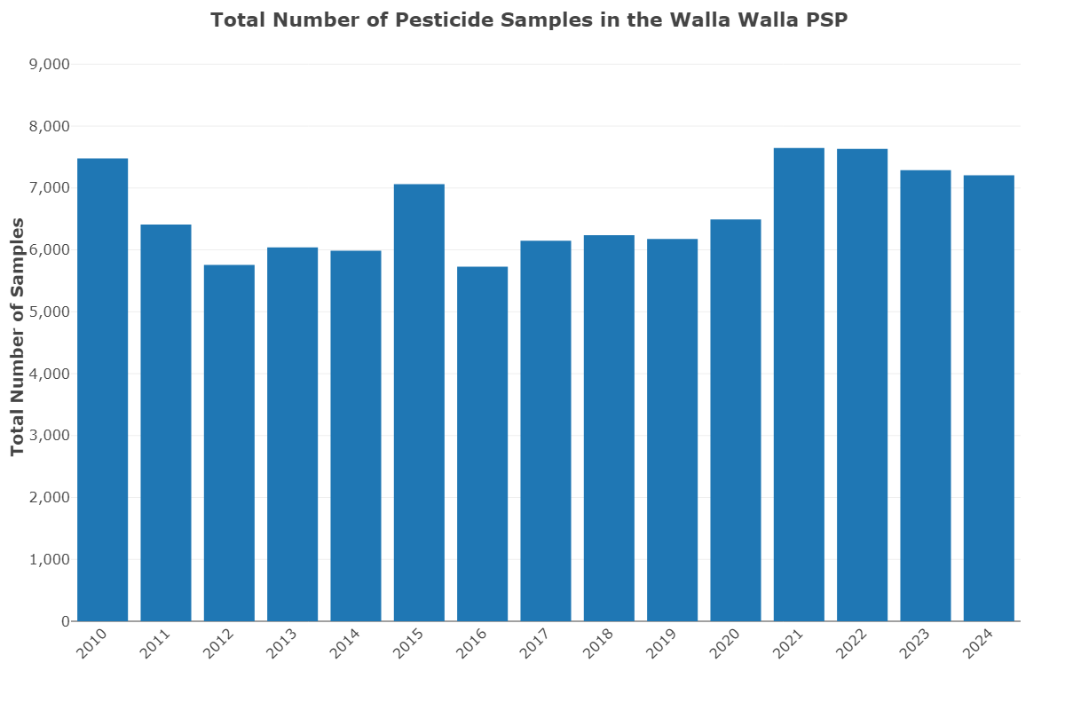

Slide 16
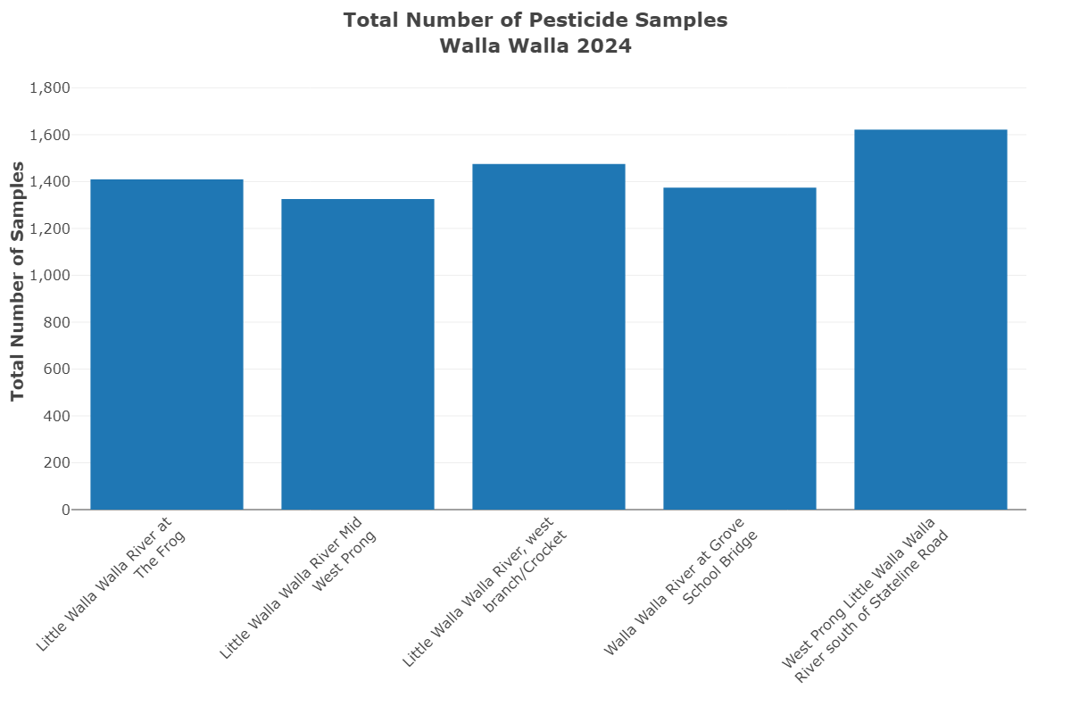

Slide 17
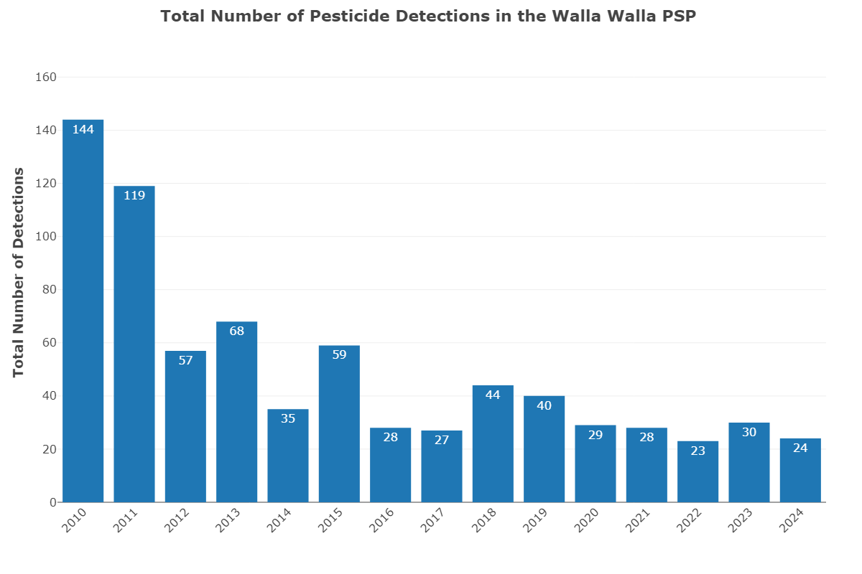

Slide 18
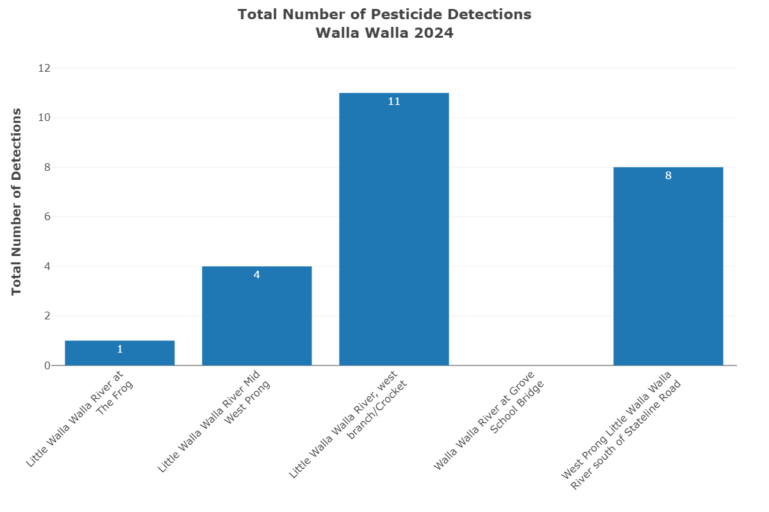

Slide 19
2024 Walla Walla PSP Sampling Locations
West Prong Little Walla Walla – south of Stateline road
Little Walla Walla – Mid Prong West
Little Walla Walla River – West Branch/Crockett
Little Walla Walla River at The Frog
Walla Walla River at Grove School Bridge

Slide 20
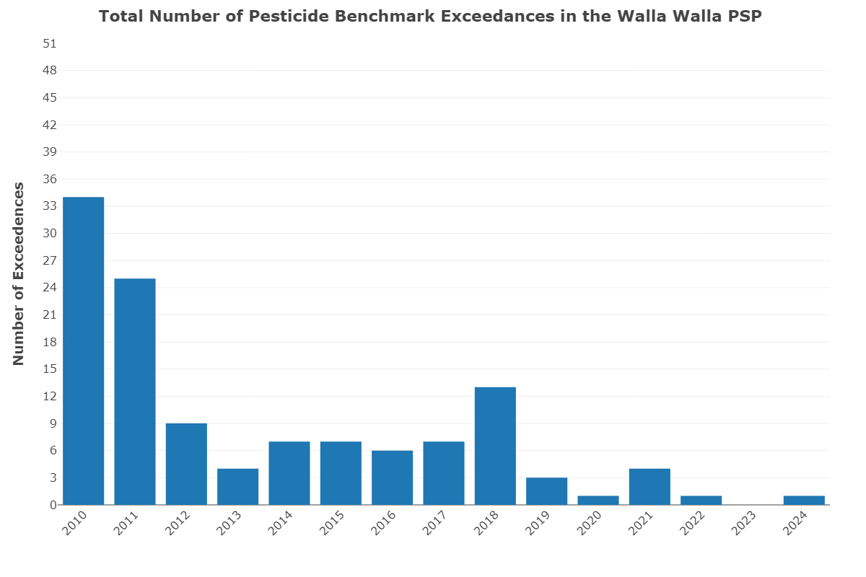

Slide 21
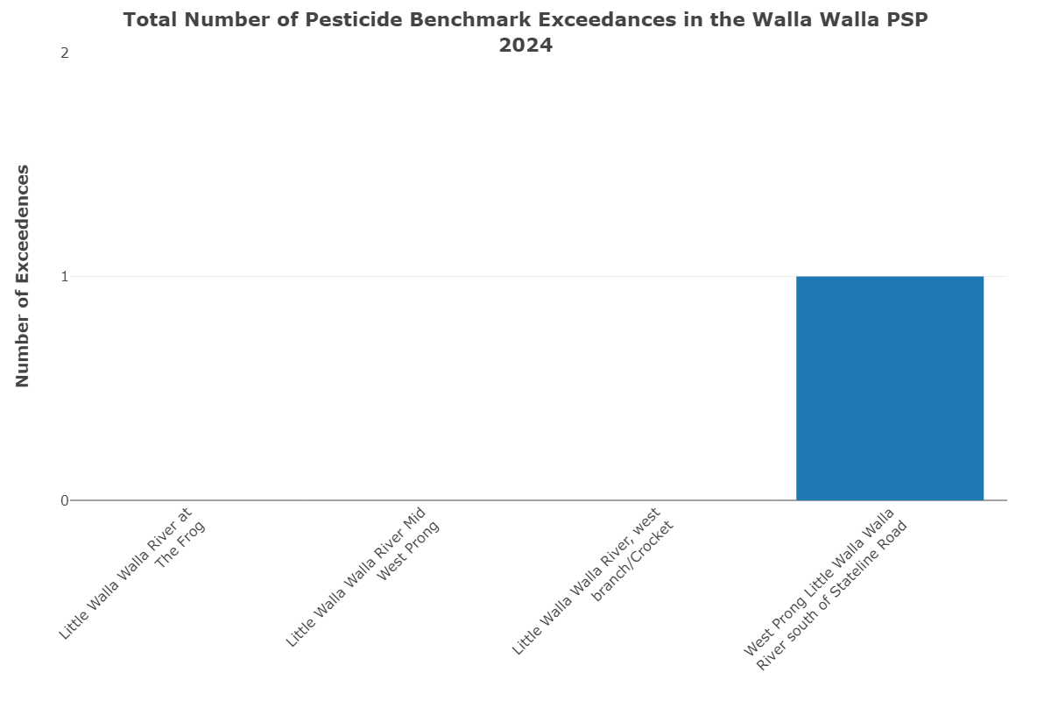

Slide 22
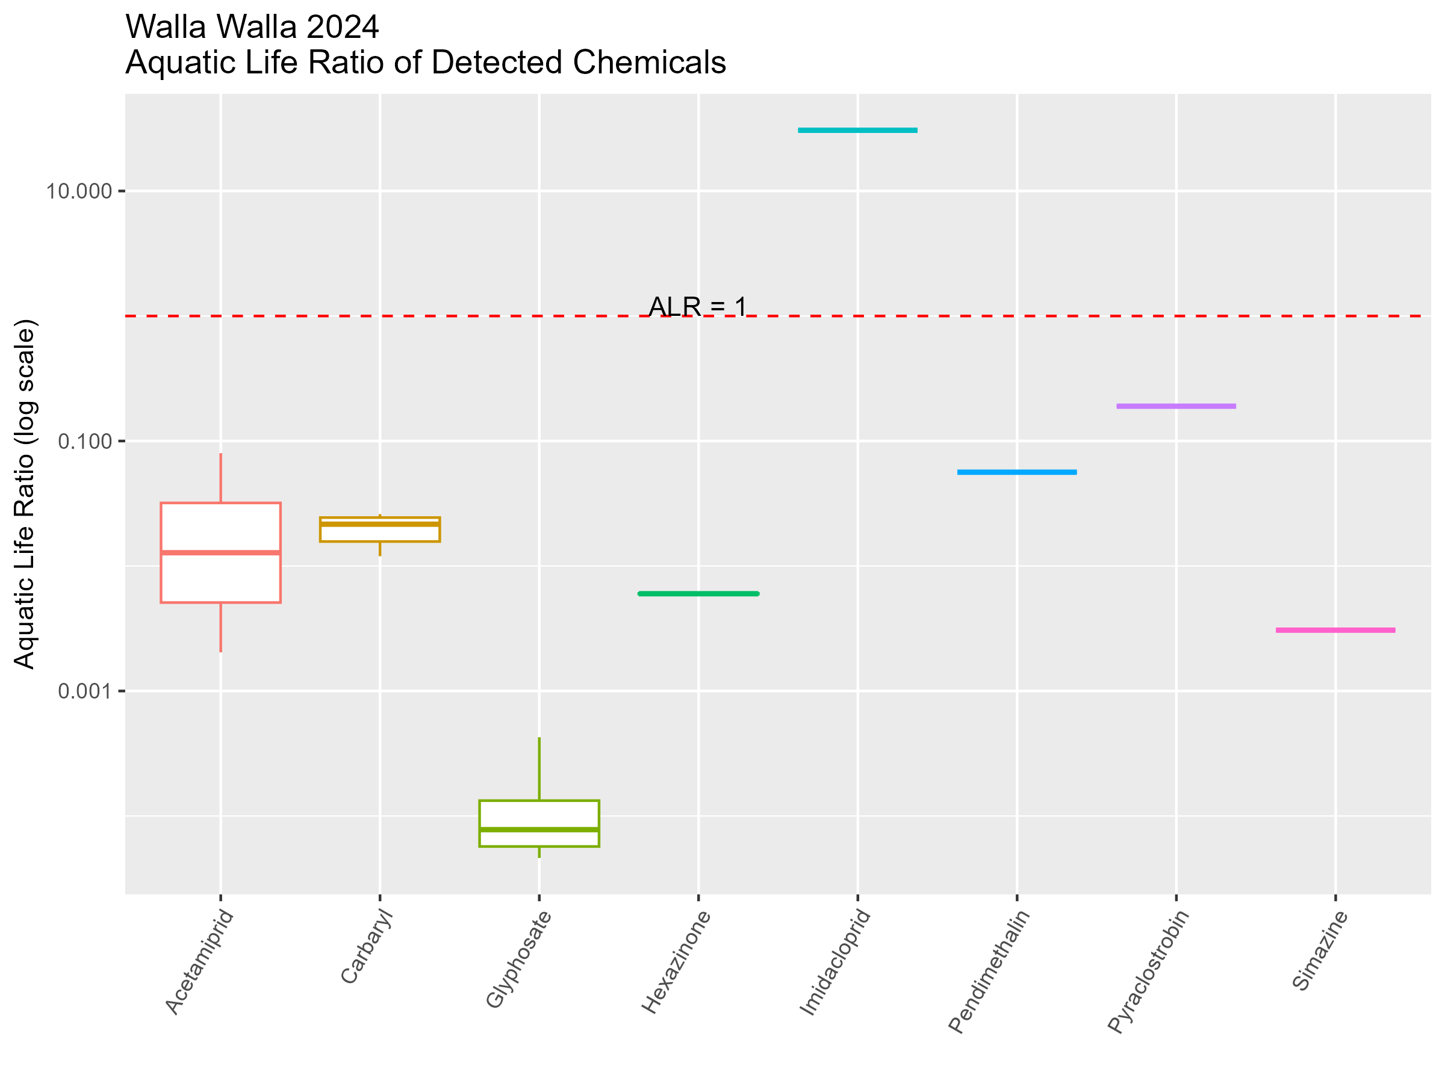

Slide 23
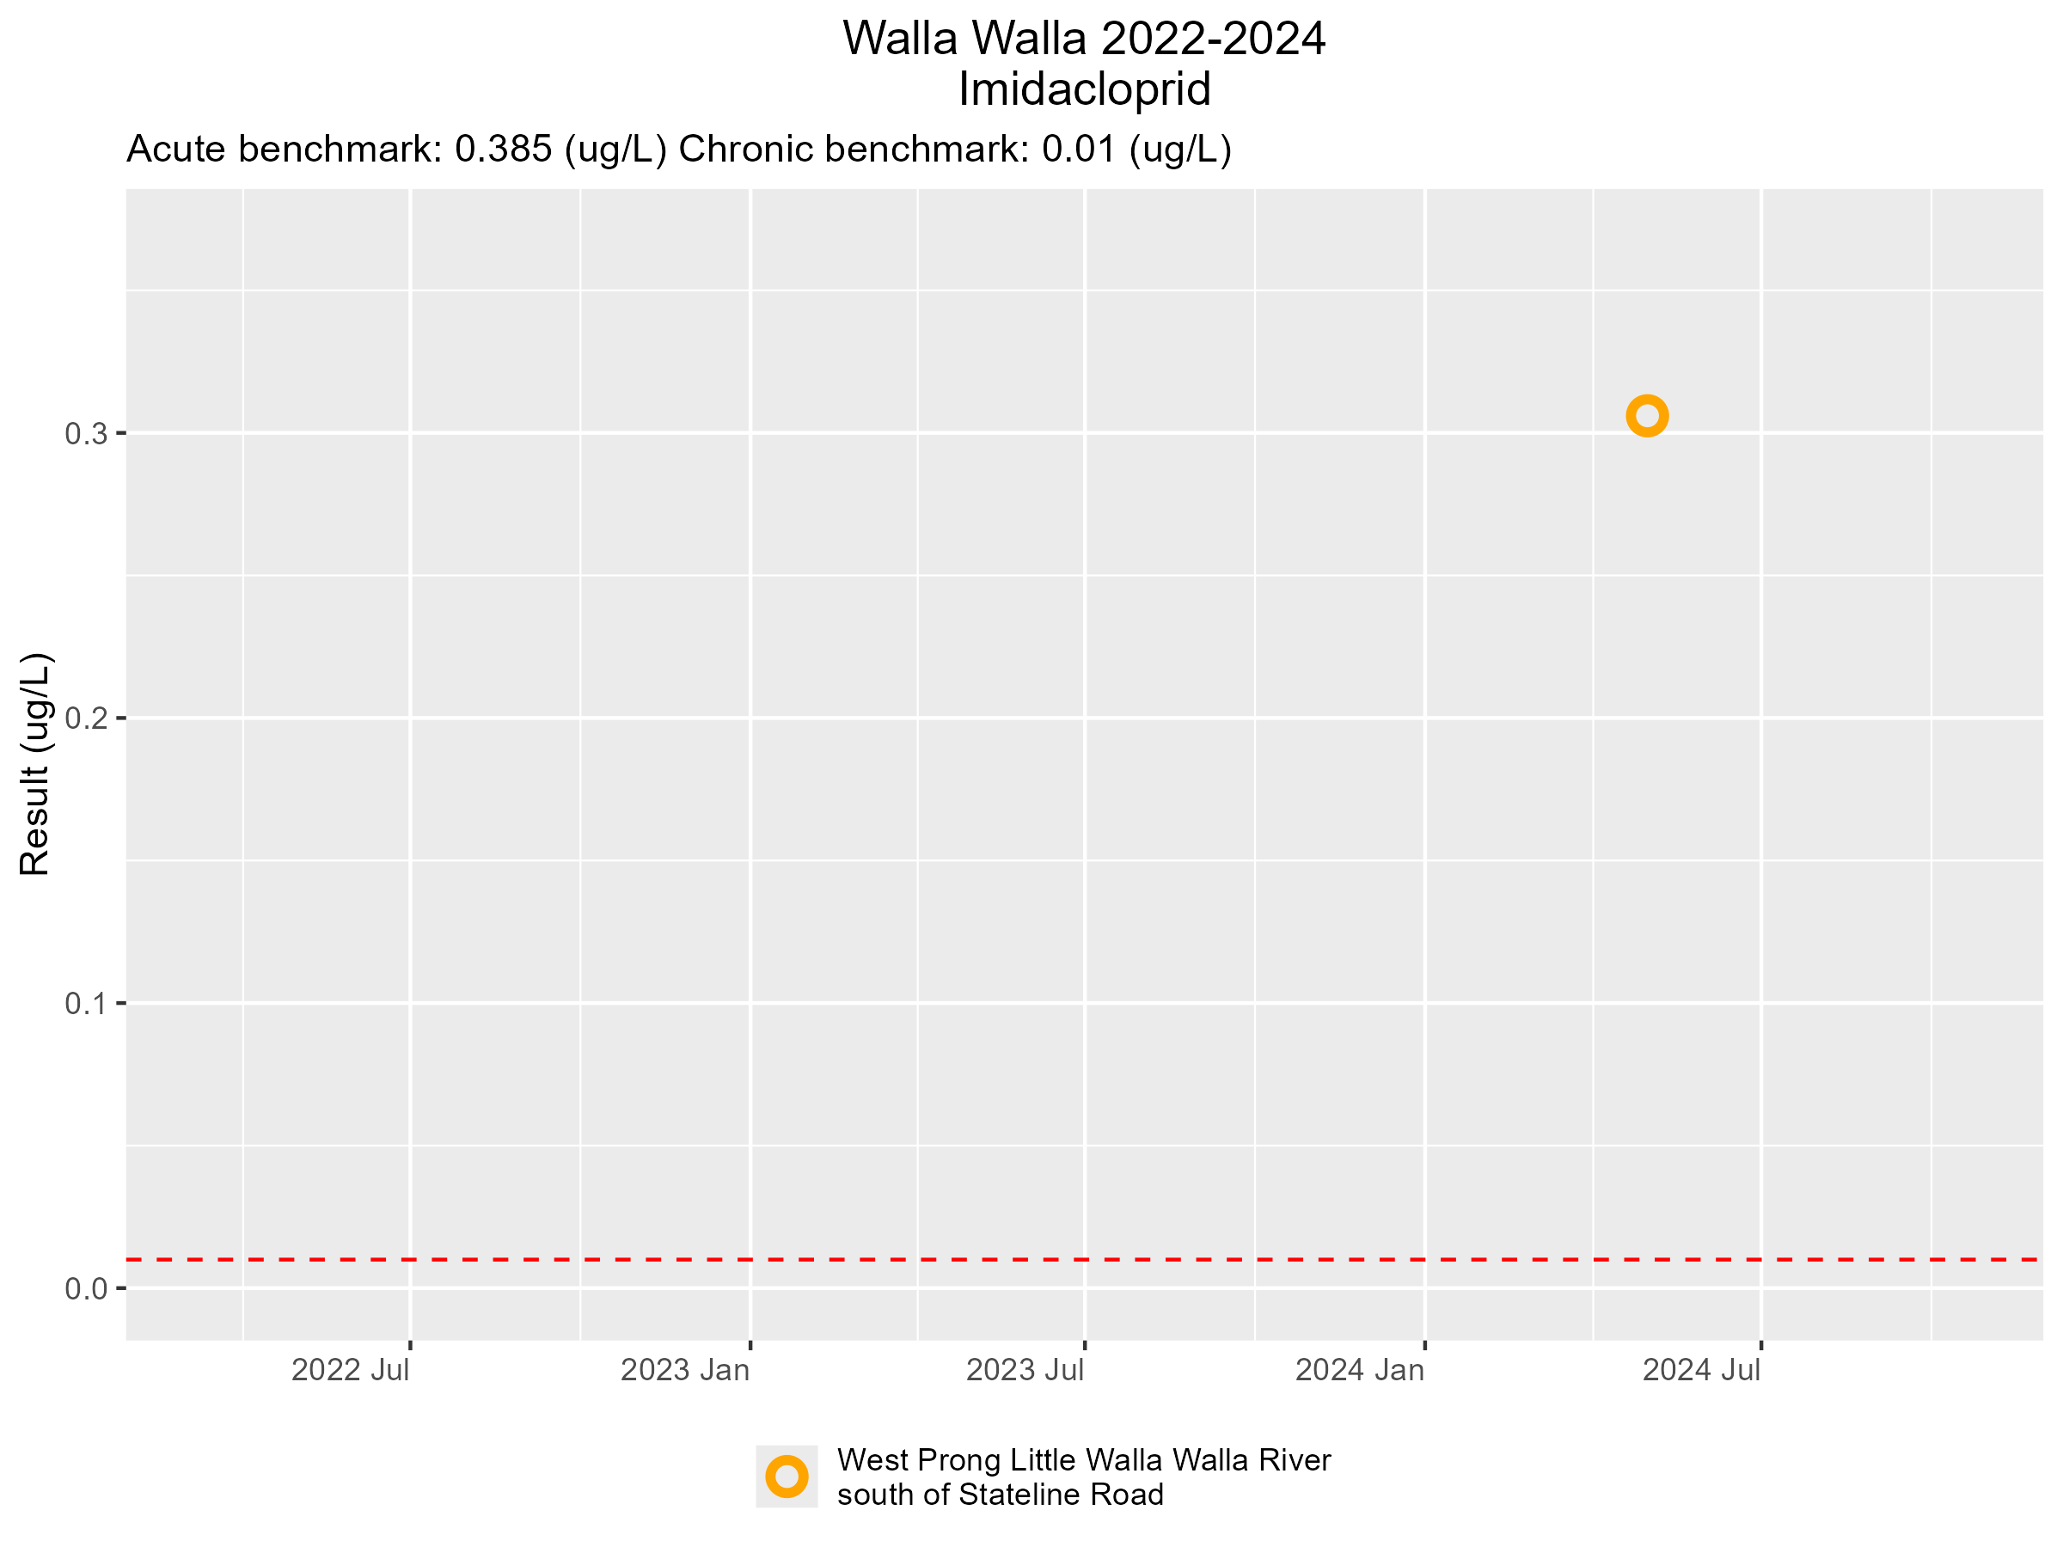

Slide 24
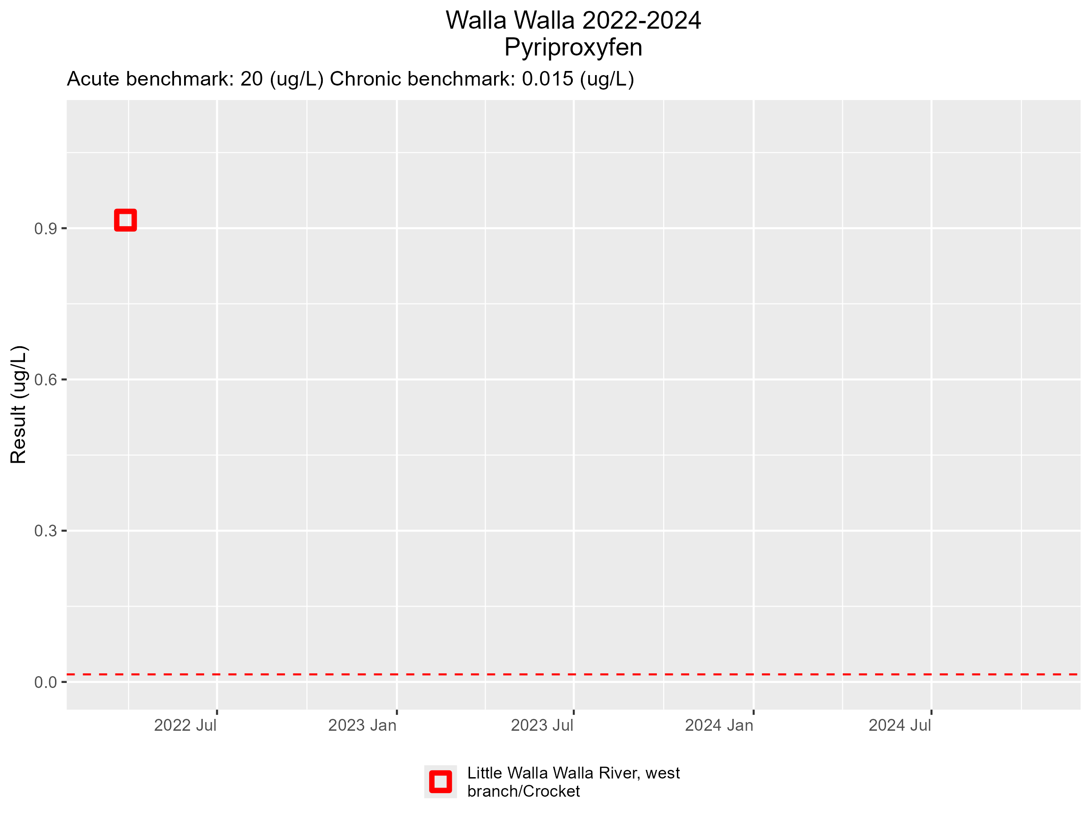

Slide 25
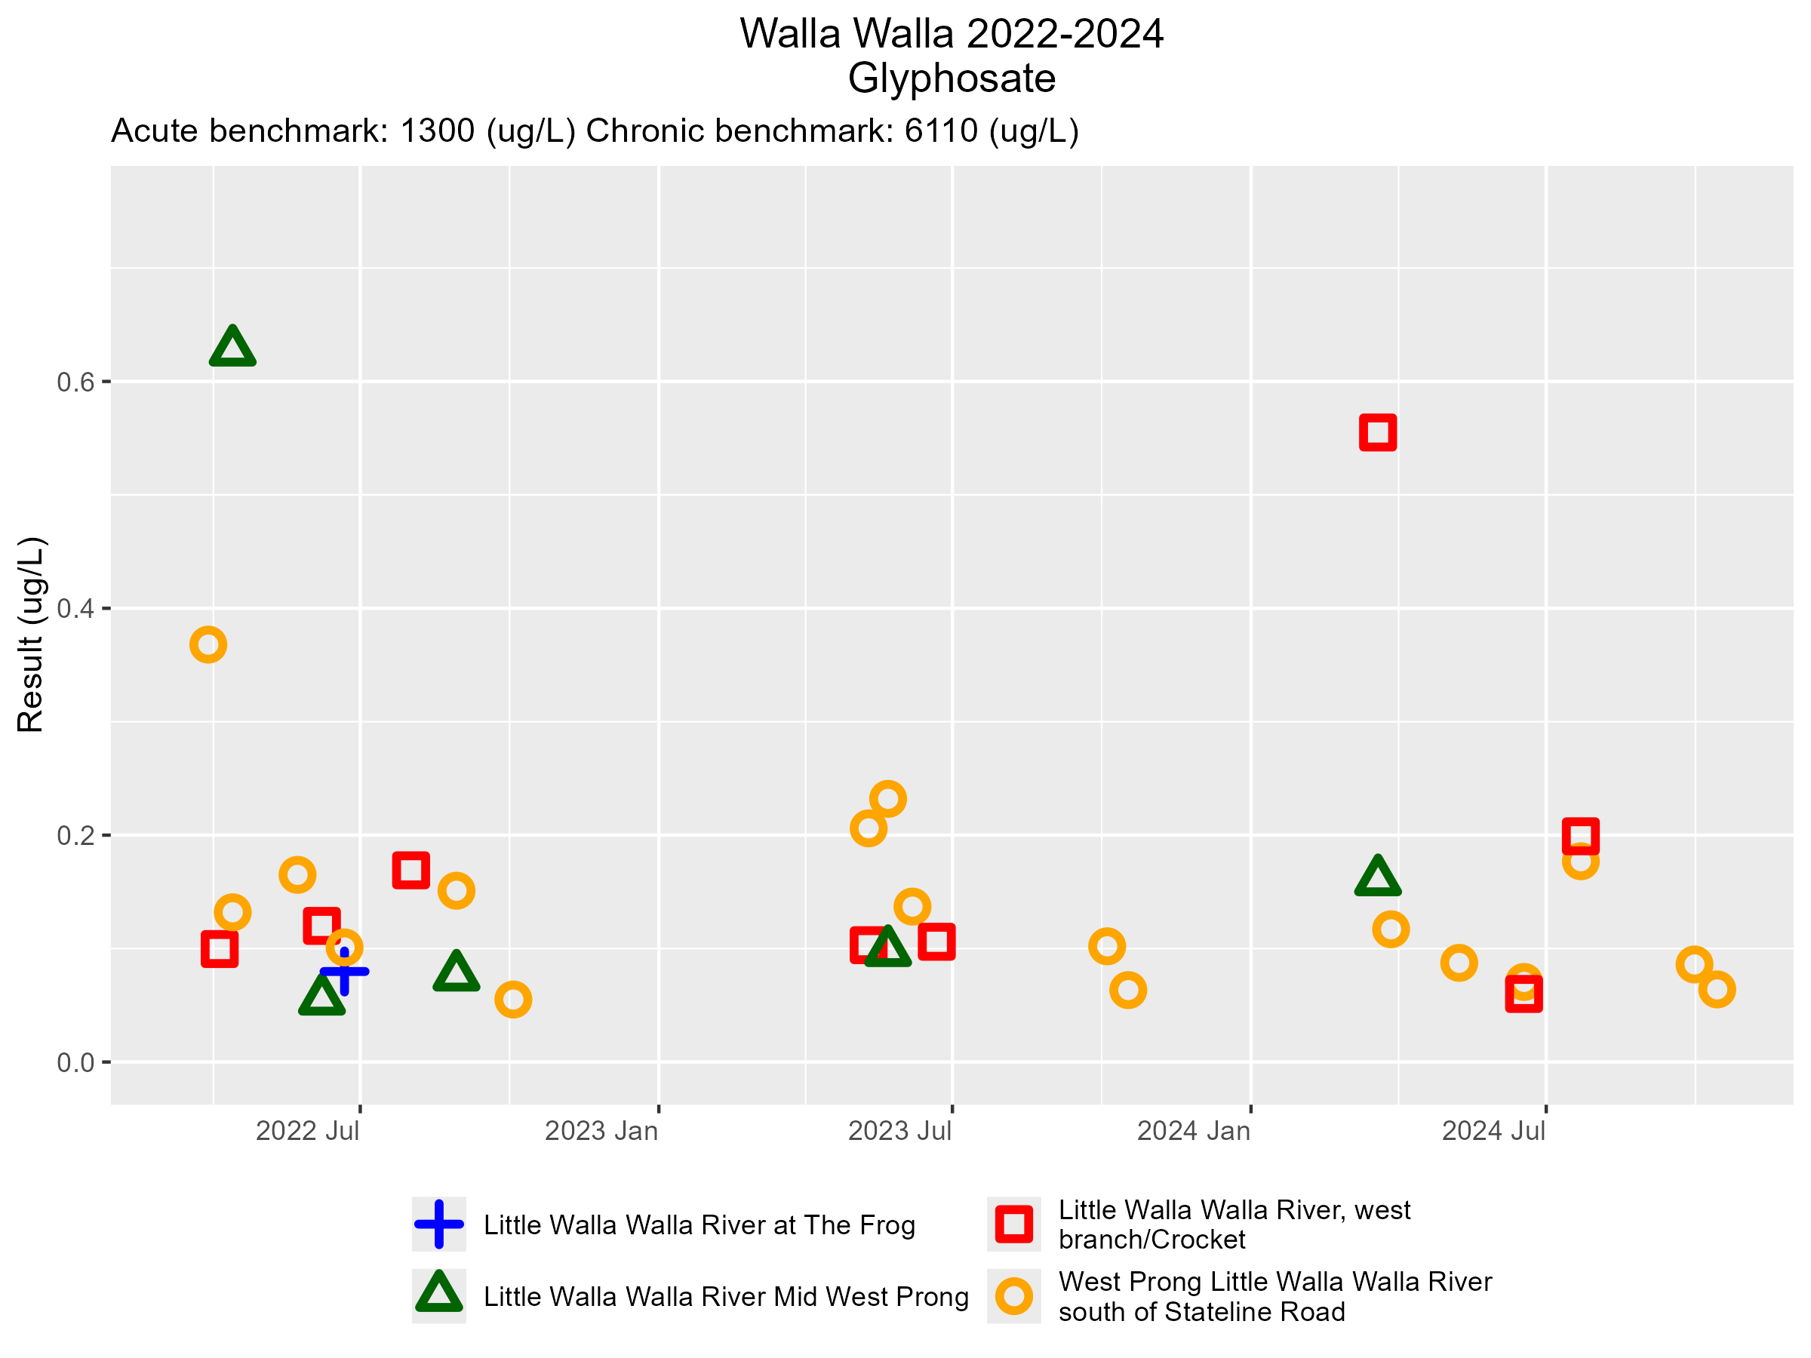

Slide 26
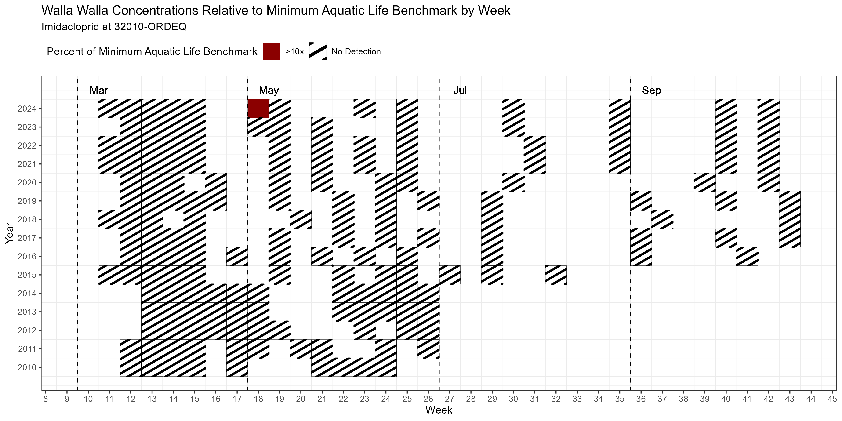
West Prong Little Walla Walla S of Stateline

Slide 27
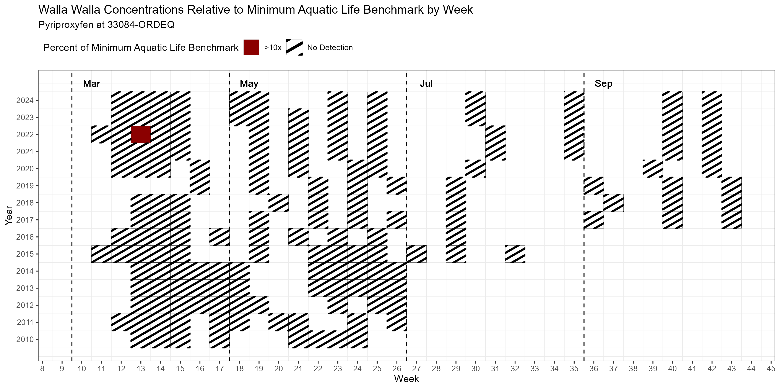
Little Walla Walla R. West Branch/Crocket

Slide 28
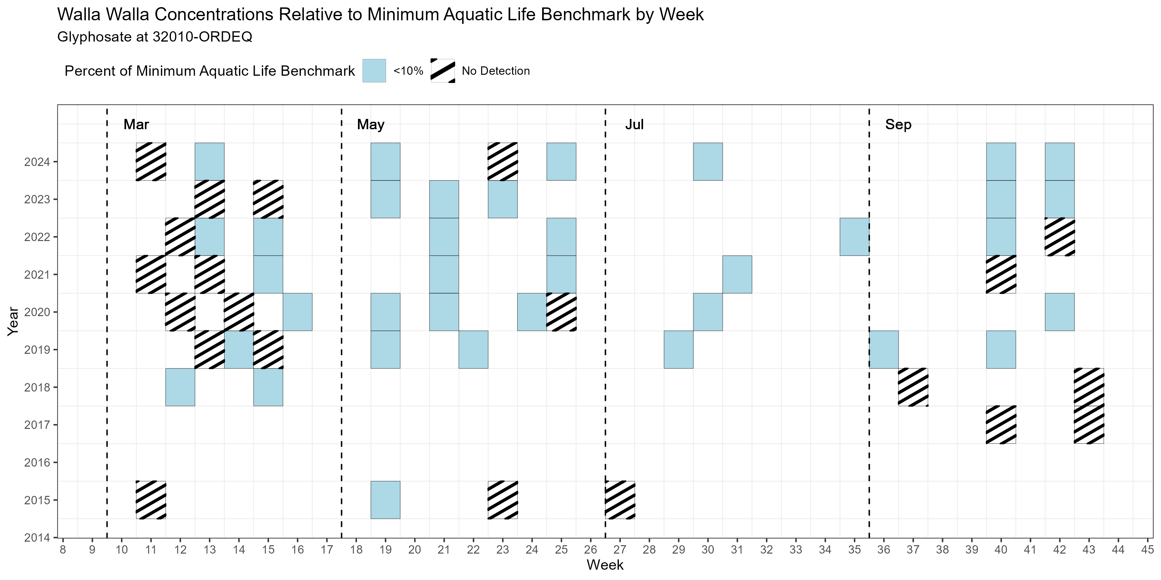
West Prong Little Walla Walla S of Stateline

Slide 29
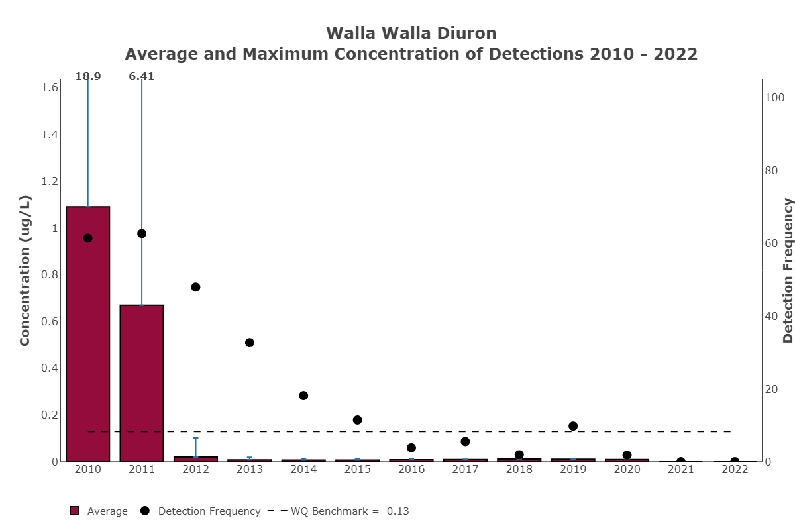

Slide 30
2024 Water Quality Data Summary
2025 Pesticides of Concern (data evaluated: 2022 – 2024)
  1 Pesticides of High Concern:
    Imidacloprid – 1 detection out of 187 samples
  2 Pesticides of Moderate Concern:
    Glyphosate – 31 detections out of 66 samples
    Pyriproxyfen – 1 detection out of 187 samples
Exceedances of Aquatic Life Benchmarks in 2024:
  Imidacloprid at West Prong Walla Walla River South of Stateline in May

Slide 31
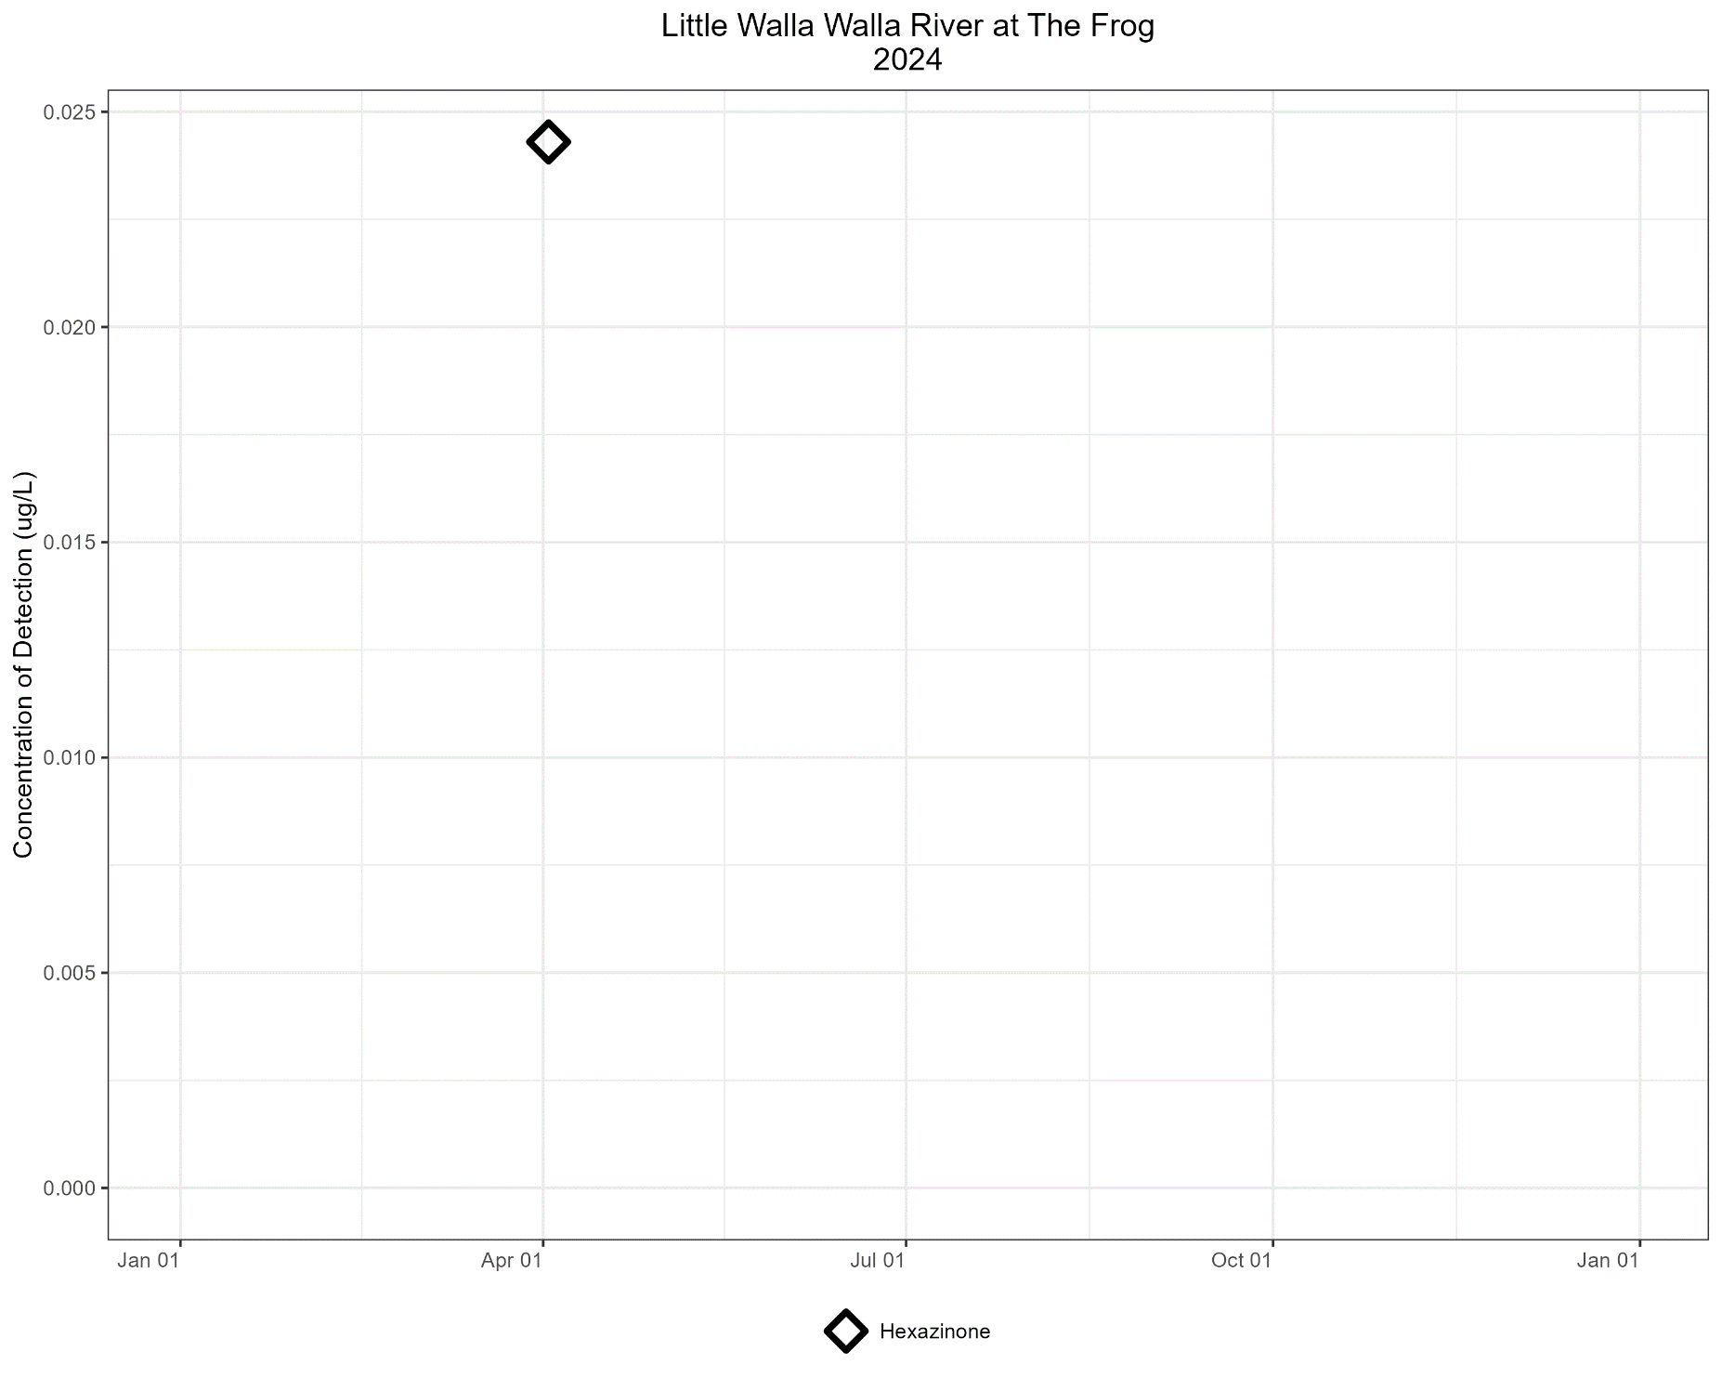

Slide 32
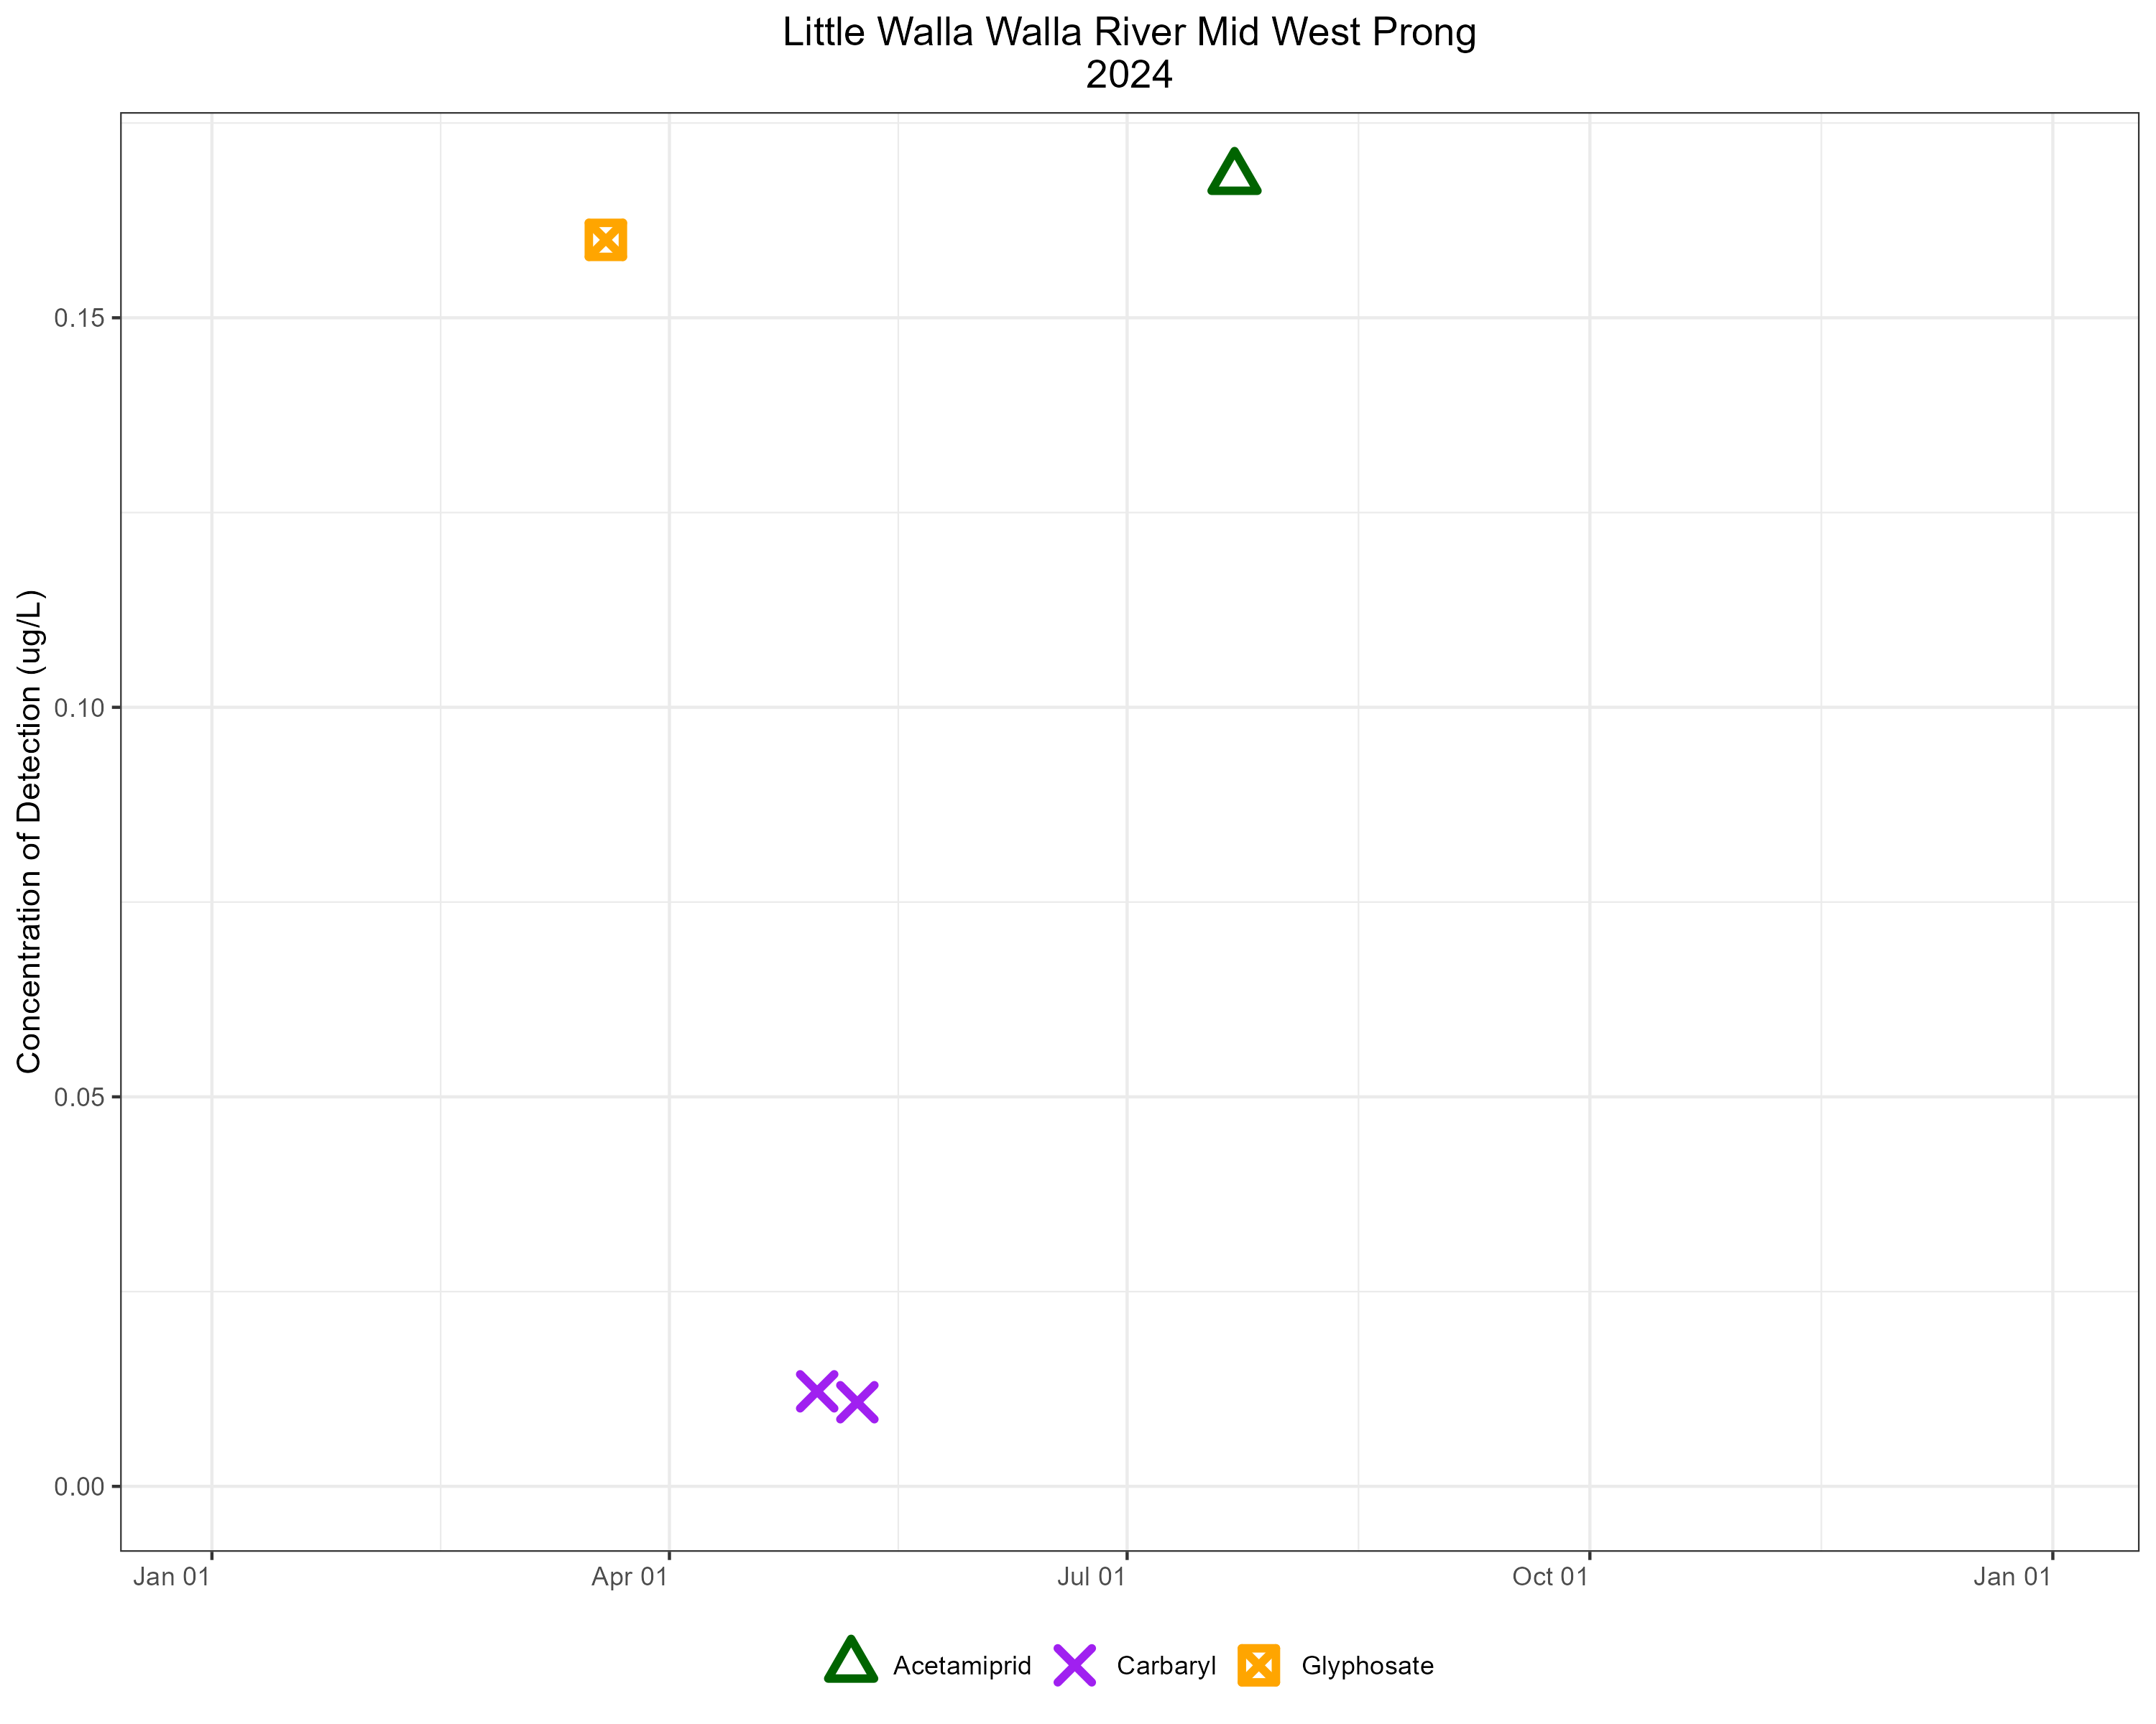

Slide 33
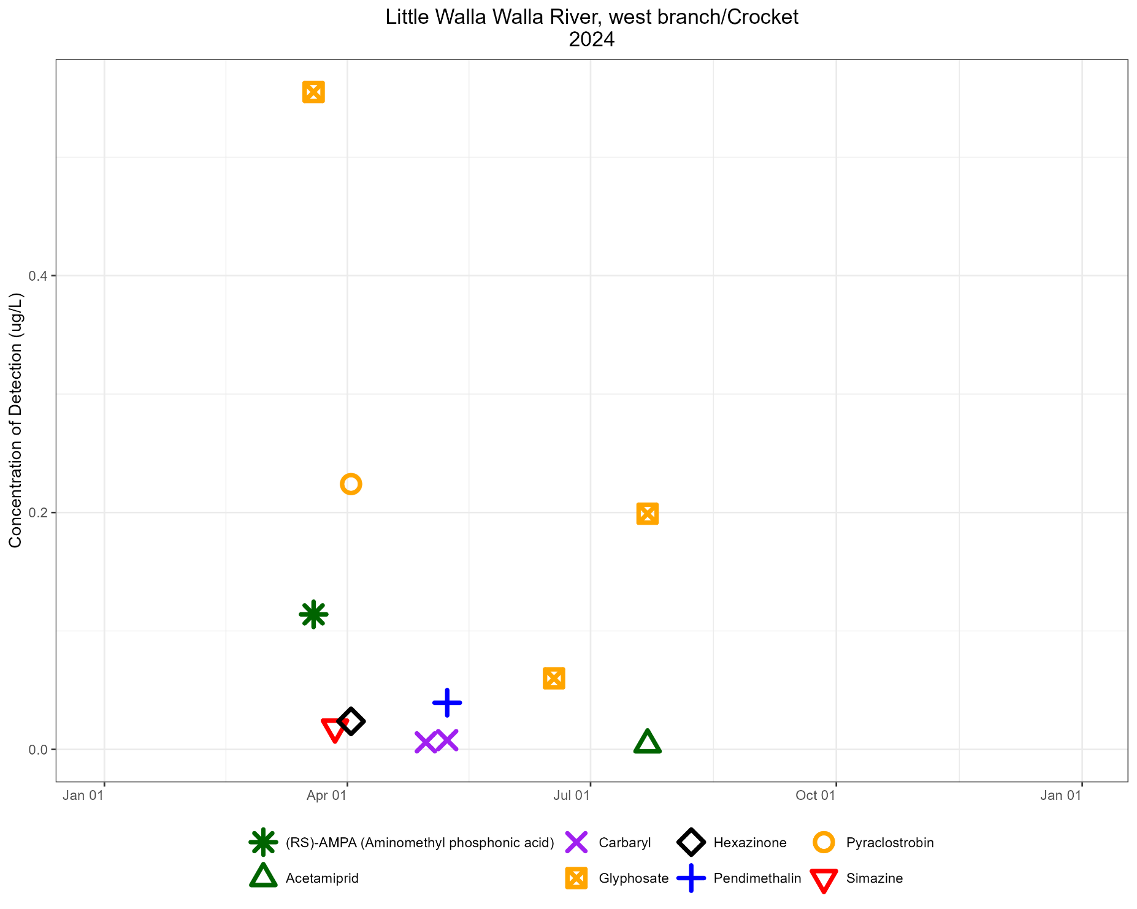

Slide 34
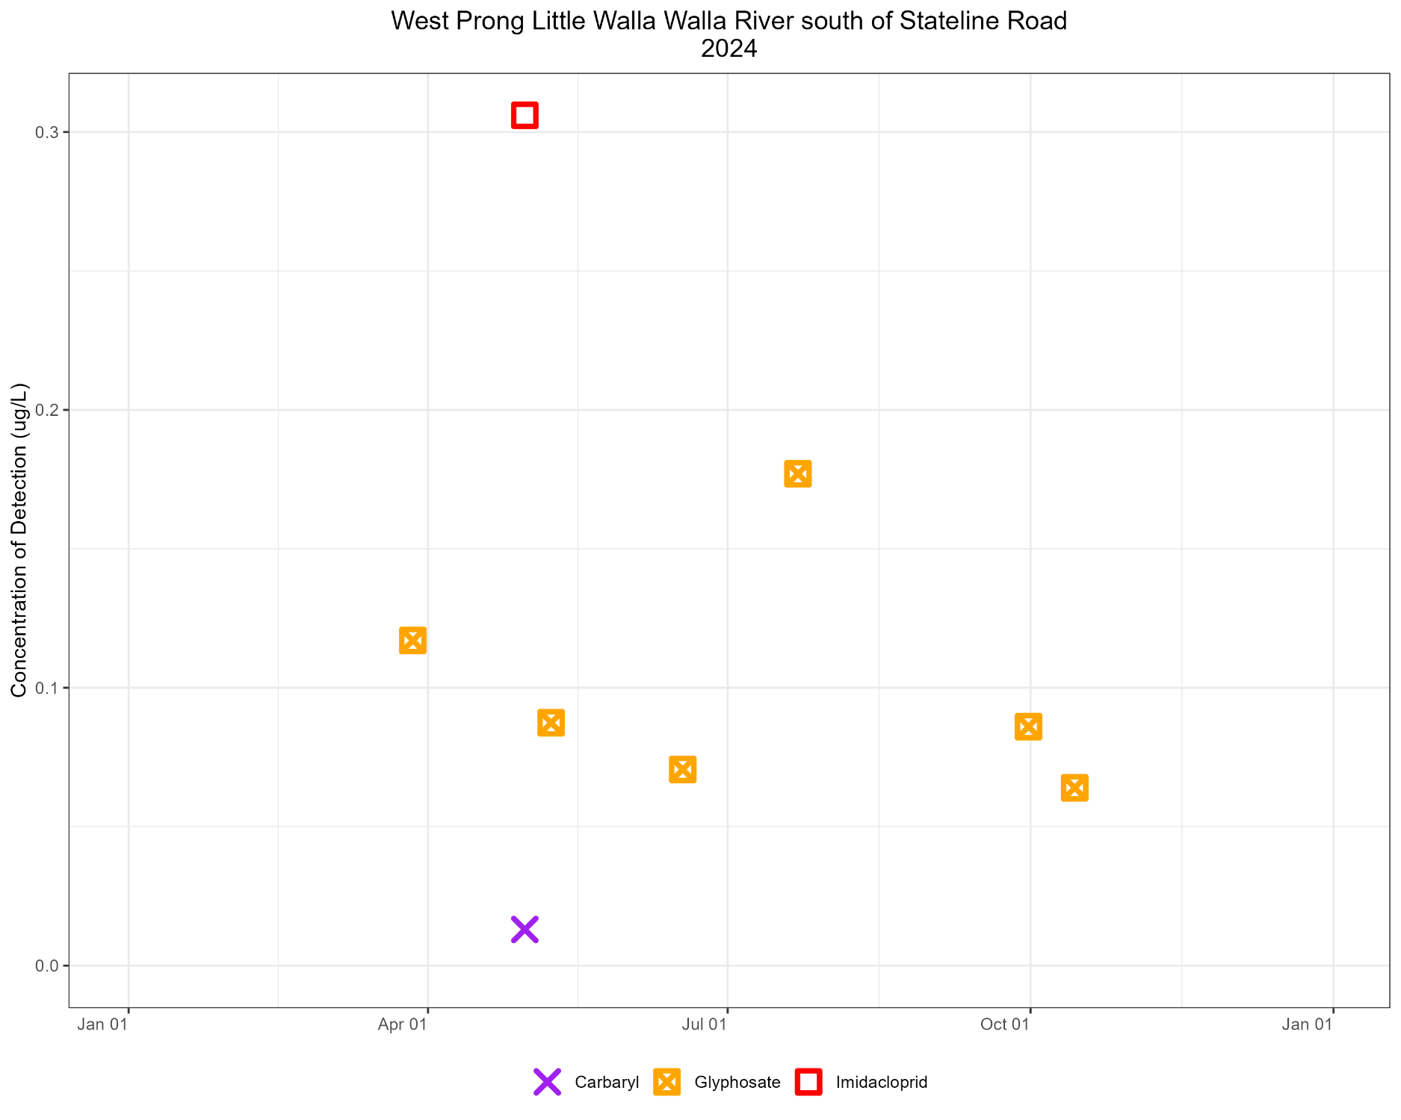

Slide 35

The End!
For more information:
David Gruen
Columbia River Coordinator
Oregon DEQ
(503) 719-2282 David.Gruen@deq.oregon.gov

